Slide 1
Introduction to CQRS and Event Sourcing
A guided tour to building event driven architectures on log structures
Presented By: Chris Berthold github.com/cberthold
twitter.com/chrisberthold

Slide 2


Slide 3
Chris Berthold : Your presenter
Over 20 years of development experience crafting and engineering software plus DevOps/network administration
10 years of business development in a manufacturing setting
6 years of development as software consultant
Private pilot
years with the awesome Product Development Team for Flightdocs
Enjoys software architecture, simplifying software design and practical performance in applications, and engaging others in software architecture
http://github.com/cberthold/presentations

Slide 4
Agenda
Exercise brain
Introduce our application and CQS
Introduce CQRS
Introduce Event Sourcing
Panic – you ran out of time
Questions & Answers

Slide 5
Ground Rules
Keep questions to end of each section
Hopefully I will explain it before then
Try to only ask questions about the topic (Event Sourcing and CQRS)
If you have specific business use cases we can talk afterwards
We’re all here to learn and we want to use the time wisely
If you plan on throwing anything, please throw money.

Slide 6

Brain Exercise
Sequence
Operations
[6] = 2
[5] = D
[4] = 3
[3] = C
[2] = 6
[1] = A
[0] = 4
0-9 – itself
A – Add
B – Subtract
C – Multiply
D - Divide

Slide 7
Brain Exercise
Think about a calculator!
[6] = 2
[5] = D
[4] = 3
[3] = C
[2] = 6
[1] = A
[0] = 4
0-9 – the number
A – Add
B – Subtract
C – Multiply
D - Divide

Slide 8
Brain Exercise
[6] = 2
[5] = D
[4] = 3
[3] = C
[2] = 6
[1] = A
[0] = 4
0-9 – itself
A – Add
B – Subtract
C – Multiply
D - Divide
Did you get 15?

Slide 9
Brain Exercise
[6] = 2
[5] = D
[4] = 3
[3] = C
[2] = 6
[1] = A
[0] = 4
0-9 – itself
A – Add
B – Subtract
C – Multiply
D - Divide
How about 2?

Slide 10
Brain Exercise
You ordered the operations
[6] = 2
[5] = D
[4] = 3
[3] = C
[2] = 6
[1] = A
[0] = 4
0-9 – itself
A – Add
B – Subtract
C – Multiply
D - Divide
Stored state
Between
operations
You mapped a sequence of operations to functions
The simplest of data structures was used to do so – An array

Slide 11
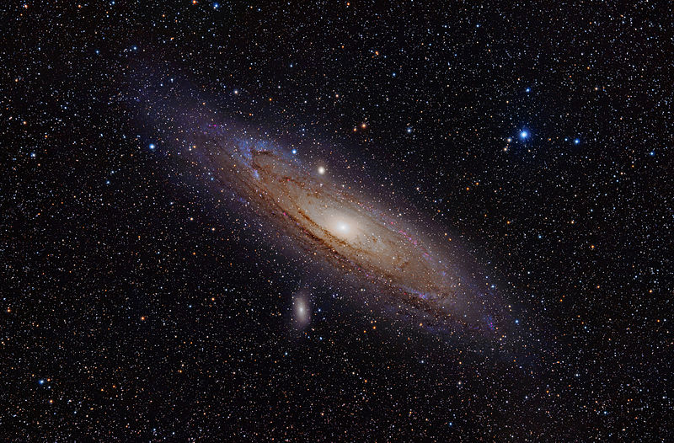
Domain Events https://docs.microsoft.com/en-us/dotnet/standard/microservices-architecture/microservice-ddd-cqrs-patterns/domain-events-design-implementation
An event is something that has happened in the past. A domain event is, something that happened in the domain that you want other parts of the same domain (in-process) to be aware of. The notified parts usually react somehow to the events.
Cannot be changed – it is immutable – it was in the past
Can be used to understand how we got to our current state
Andromeda Galaxy – 2.5 million light years

Slide 12
Event Sourcing https://docs.microsoft.com/en-us/azure/architecture/patterns/cqrs
Event sourcing involves modeling the state changes made by applications as an immutable sequence or “log” of events.
Event Stream
Sequence | AggregateId | Version | Event Type | Data
9 | Acct#1 | 4 | AccountClosed | { Date: ‘4/3/2018’ }
8 | Acct#2 | 5 | AmountWithdrawn | { Date: ‘…’, Amount: 4 }
7 | Acct#2 | 4 | AmountDeposited | { Date: ‘…’, Amount: 4 }
6 | Acct#2 | 3 | AmountDeposited | { Date: ‘…’, Amount: 4 }
5 | Acct#2 | 2 | AmountDeposited | { Date: ‘…’, Amount: 4 }
4 | Acct#2 | 1 | AccountOpened | { Date: ‘3/2/2011’ }
3 | Acct#1 | 3 | AmountWithdrawn | { Date: ‘…’, Amount: 5 }
2 | Acct#1 | 2 | AmountDeposited | { Date: ‘…’, Amount: 15 }
1 | Acct#1 | 1 | AccountOpened | { Date: ‘1/1/2011’ }

Slide 13
Brain Exercise – You already did it The mental model of event sourcing
[6] = 0 - NumberPressed
[5] = D - OperatorPressed
[4] = 3 - NumberPressed
[3] = C – OperatorPressed
[2] = 6 - NumberPressed
[1] = A - OperatorPressed
[0] = 4 - NumberPressed
0-9 – itself
A – Add
B – Subtract
C – Multiply
D - Divide
Stored State
Current Total
Last Operator Pressed
You’re set for Event Sourcing

Slide 14
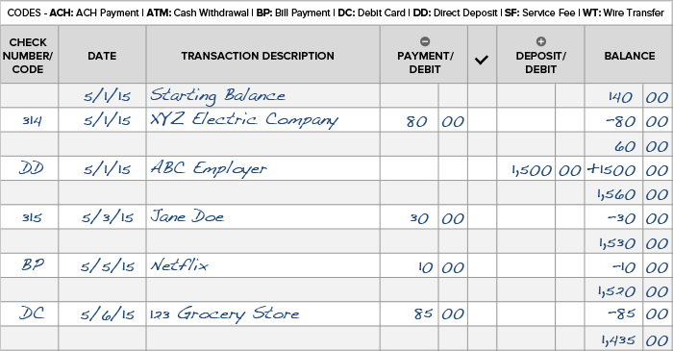
Our Application – A simple bank
Deposits – add money
Withdrawals – remove money
Balance – add it together
List transactions

Slide 15
Let’s see the application
DEMO

Slide 16
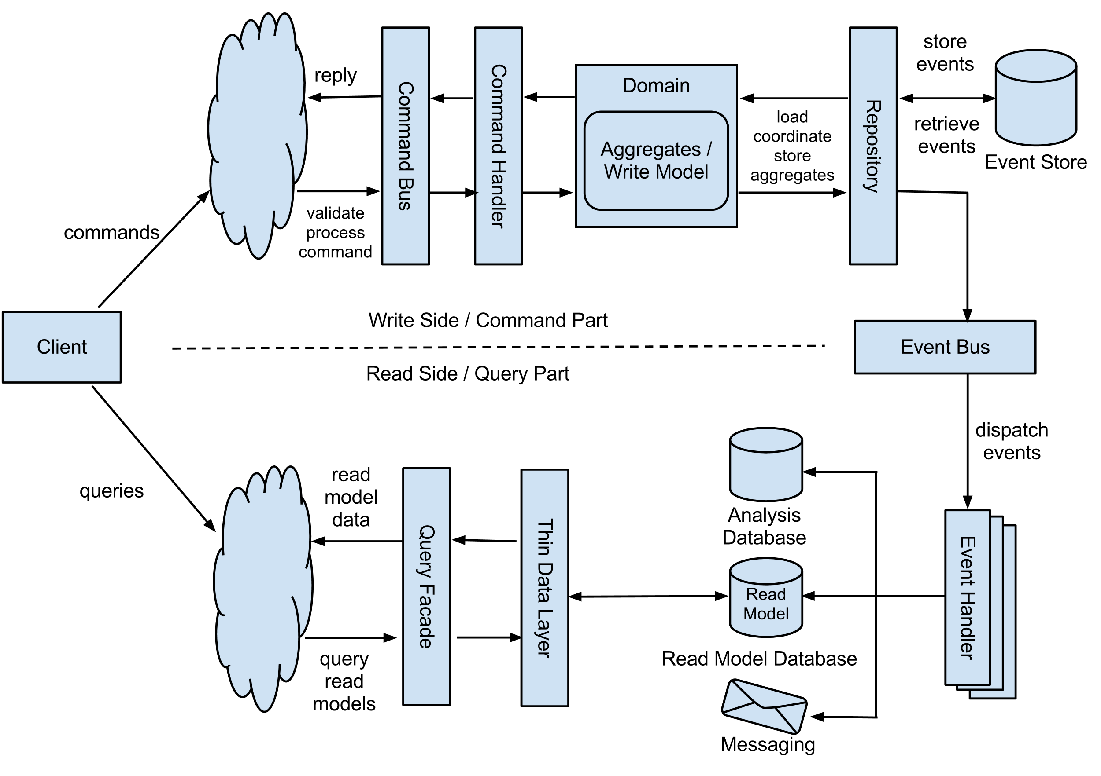
Target Architecture

Slide 17
CQS – Command Query Separation https://martinfowler.com/bliki/CommandQuerySeparation.html
The term 'command query separation' was coined by Bertrand Meyer in his book "Object Oriented Software Construction “…
The fundamental idea is that we should divide an object's methods into two sharply separated categories:
Queries: Return a result and do not change the observable state of the system (are free of side effects).
Commands: Change the state of a system but do not return a value.
Queries - Reads are bi-directional, tend to be simple, and different per UI (mobile, web, etc)
Writes – usually always complex and domain doesn’t always match what UI expects

Slide 18
CQRS – Command Query Responsibility Segregation https://docs.microsoft.com/en-us/azure/architecture/patterns/cqrs
Command and Query Responsibility Segregation (CQRS) is a pattern that segregates the operations that read data (queries) from the operations that update data (commands) by using separate interfaces. This means that the data models used for querying and updates are different. The models and data can then be isolated although that's not an absolute requirement.
Making two objects when there used to be only one

Slide 19
Materialized view https://en.wikipedia.org/wiki/Materialized_view
In computing, a materialized view is a database object that contains the results of a query. For example, it may be a local copy of data located remotely, or may be a subset of the rows and/or columns of a table or join result, or may be a summary using an aggregate function.
Could be Indexed View in SQL Server
Precalculated view – might also be in document db or other storage mechanism

Slide 20
Eventual Consistency https://en.wikipedia.org/wiki/Eventual_consistency
Eventual consistency is a consistency model used in distributed computing to achieve high availability that informally guarantees that, if no new updates are made to a given data item, eventually all accesses to that item will return the last updated value.
Tend to see this in event driven architectures
Events are read when available to update read data structures

Slide 21
Domain Aggregate https://medium.com/capital-one-tech/event-sourcing-with-aggregates-in-rust-4022af41cf67
The aggregate is a domain-driven-design (DDD) concept that fits well within event sourcing. To put it as briefly as possible: you apply a command to an aggregate which then produces one or more events. An aggregate can populate (re-hydrate) its state by sequential application of an event stream.
Enforces its current state
Prevents new events from being created unless domain is true

Slide 22
The good and the bad
Scales well
Events can be looked at in different ways to create new views of the world
Easy to debug what happened in the system
Natural fit with streaming business intelligence platforms like kafka and spark
Automatically get an audit log of all things that occur in the system
Technically challenging
Steep learning curve
Versioning is hard
Deployment is hard
Event Sourcing frameworks usually make choices about making things general easy and not performant or easy for all cases

Slide 23
Additional Resources
https://leanpub.com/esversioning/read - Greg Young’s ES versioning book
https://github.com/heynickc/awesome-ddd – Curated list of Domain Driven Design resources
https://github.com/leandrocp/awesome-cqrs-event-sourcing - Curated list of CQRS and ES resources
https://www.amazon.com/Patterns-Principles-Practices-Domain-Driven-Design/dp/1118714709/ - Great book that takes you through many of the principles of Domain Driven Design. Takes you into Aggregates, Events, Event Sourcing, Integrations, etc.

